Slide 1
JavaScript Objects
Web 3

Slide 2
JavaScript Objects
JavaScript is not a full-fledged object-oriented programming language
It does not have stereotypical classes per se
It does not support many of the patterns you’d expect from an object-oriented language like inheritance and polymorphism in a straightforward way

Slide 3
JavaScript Objects
The language does, however, support objects
User-defined objects are declared in a slightly odd way to developers familiar with languages like C++ or Java
the syntax to build pseudo-classes can be challenging
Nonetheless the advantages of encapsulating data and methods into objects outweigh the syntactic hurdle you will have to overcome.

Slide 4
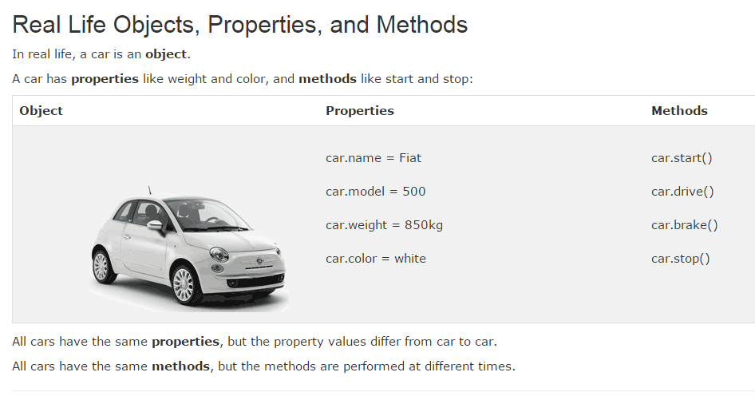
Objects

Slide 5
Properties
Each object might have properties that can be accessed, depending on its definition
When a property exists, it can be accessed using dot notation where a dot between the instance name and the property references that property

Slide 6
Methods
Objects can also have methods, which are functions associated with an instance of an object.
These methods are called using the same dot notation as for properties, but instead of accessing a variable, we are calling a method
Methods may produce different output depending on the object they are associated with because they can utilize the internal properties of the object

Slide 7
Constructors
Normally to create a new object we use the new keyword, the class name, and ( ) brackets with n optional parameters inside, comma delimited
For some classes, shortcut constructors are defined, which can be confusing if we are not aware of them.

Slide 8
Objects included in JavaScript
A number of useful objects are included with JavaScript
These include Array, Boolean, Date, Math, String, and others
JavaScript can also access Document Object Model (DOM) objects that correspond to the content of a page’s HTML
These DOM objects let JavaScript code access and modify HTML and CSS properties of a page dynamically

Slide 9

Math
The Math class allows one to access common mathematic functions and common values quickly in one place.
This static class contains methods such as max(), min(),
pow(), sqrt(), and exp(), and trigonometric functions such as sin(), cos(), and arctan().
In addition, many mathematical constants are defined such as PI, E (Euler’s number), SQRT2, and some others

Slide 10
Strings
The string class is core to communicating with the user
A common need is to get the length of a string
Another common need when working with strings is to concatenate them together. The + operator has been overridden to allow for concatenation in place

Slide 11
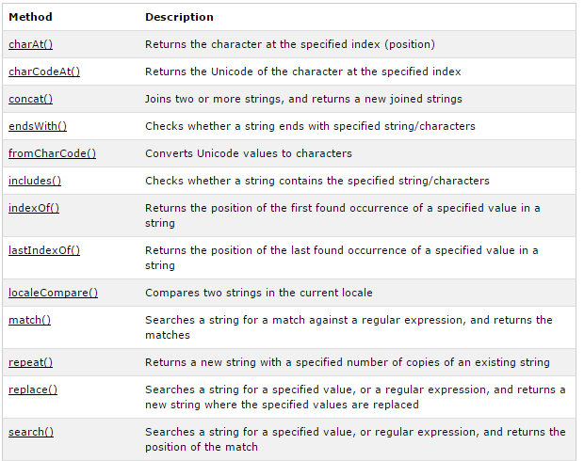
String Methods

Slide 12
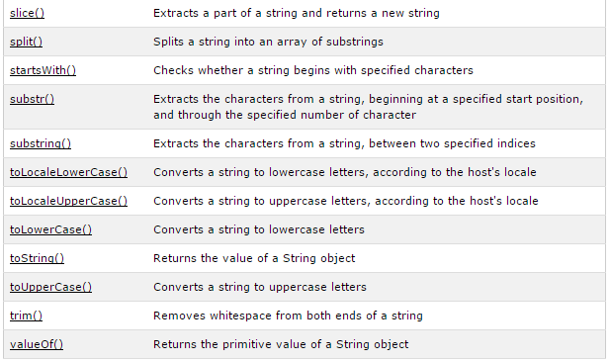
String Methods

Slide 13

Date
the Date class allows you to quickly calculate the current date or create date objects for particular dates.
To display today’s date as a string, we would simply create a new object and use the toString() method

Slide 14
Window object
The window object in JavaScript corresponds to the browser itself
Through it, you can access the current page’s URL, the browser’s history, and what’s being displayed in the status bar, as well as opening new browser windows.
The alert() function is actually a method of the window object

Slide 15
Arrays
Arrays are one of the most used data structures included in JavaScript as well
This class is defined to behave more like a linked list in that it can be resized dynamically, but the implementation is browser specific meaning the efficiency of insert and delete operations is unknown
Arrays will be the first objects we will examine. Objects can be created using the new syntax and calling the object constructor.

Slide 16
Arrays
You can initialize a race with values in the variable declaration with 2 different notations:
To access an element in the array you use the familiar square bracket notation
To add an item to an existing array, you can use the push method
Additional methods that modify arrays include concat(), slice(), join(), reverse(), shift(), and sort()

Slide 17

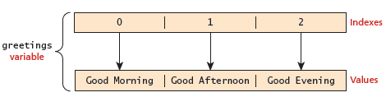
Arrays
One of the most common actions on an array is to traverse through the items sequentially
The following for loop quickly loops through an array, accessing the i^{th} element each time using the Array object’s length property to determine the maximum valid index

Slide 18
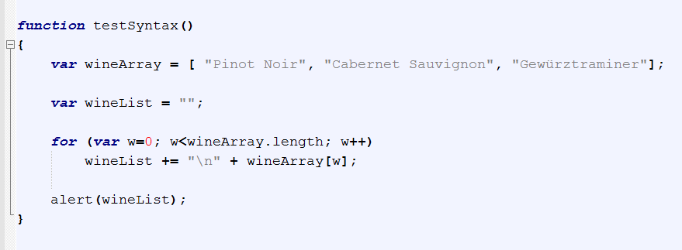
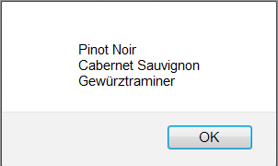
Arrays

Slide 19
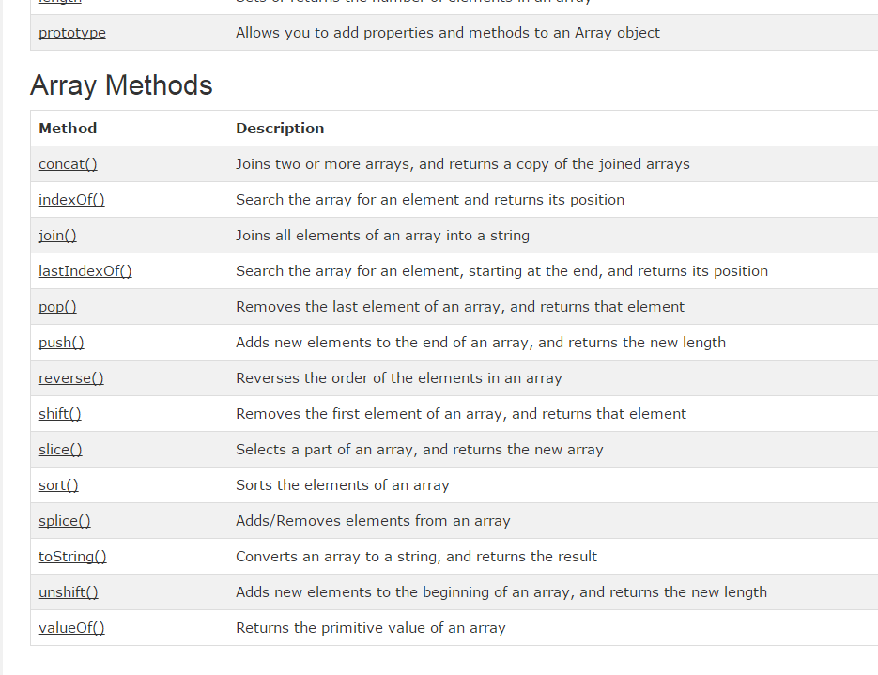

Slide 20
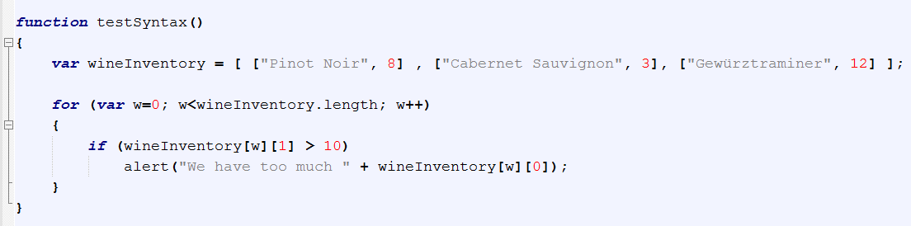
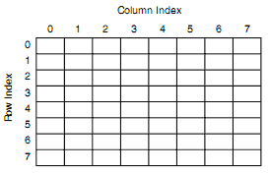
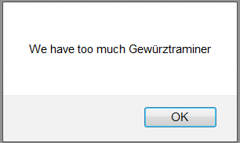
2D Arrays

Slide 21
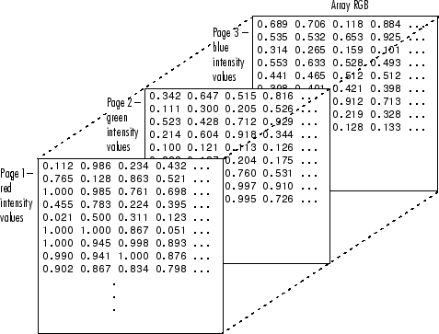
3D Arrays

Slide 22
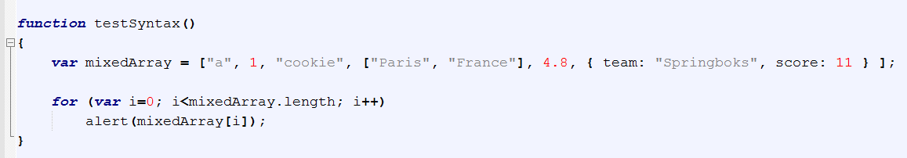
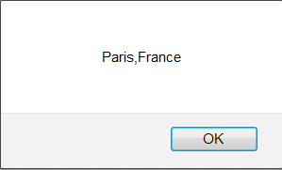
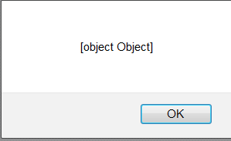
Arrays containing multiple types

Slide 23
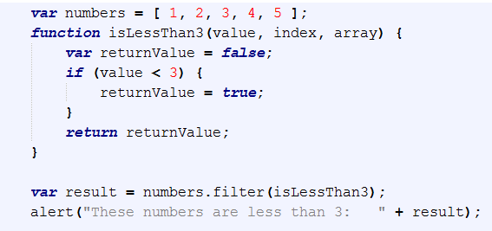
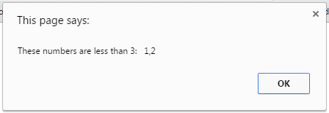
Iterating through an array without loops - Testing Each Element

Slide 24
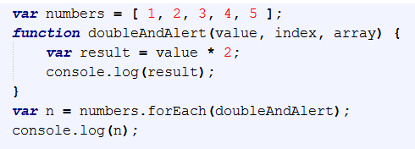
Iterating through an array without loops – operating on elements

Slide 25
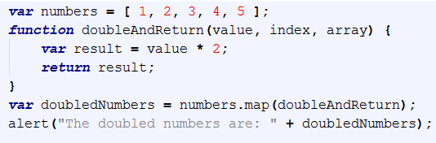
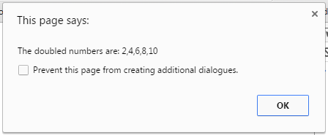
Iterating through an array without loops – operating on elements

Slide 26
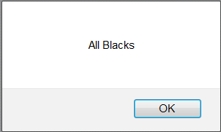
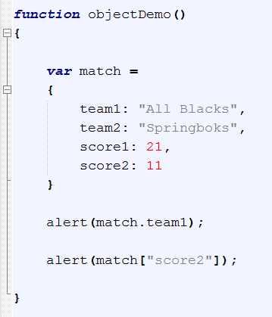
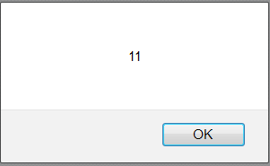
Complex Data Types
Objects

Slide 27


Instantiating Objects

Slide 28
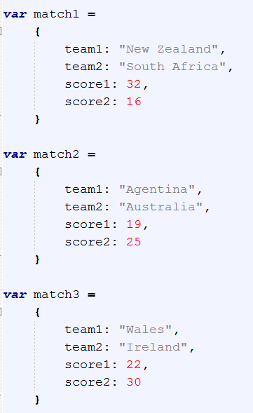
Instantiating Objects
How do we create multiple instances?
Here is one approach. When objects are created like this, they are called “object literals”.
But this gets to be a huge pain.
Coming from an OO perspective, what would you really like to have here? => A constructor.
Even though we haven’t defined a class (it doesn’t work quite like that in JavaScript), we’d still like to have a template method for creating instances of a particular object type (the logical equivalent of a constructor).

Slide 29
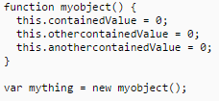
this keyword
Any function in JavaScript can be used to create custom object classes, simply by calling it using the keyword new
When called in this way, the special variable this inside the function references the new object that is being constructed (it normally refers to the 'current' object, which is usually window, except inside methods)
The function should not return a value. The following function can be used as demonstrated to create an object of type myobject

Slide 30
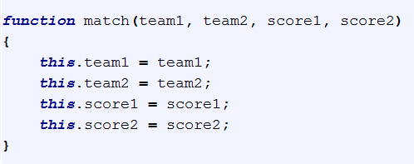
Constructor
Unlike C++ or C#, you don’t have to predeclare the fields and methods your object will hold. You just write the constructor.
This is consistent with the whole “no variable declaration required” approach to object creation.
And here’s how you create one of these instances…Note the use of the new keyword.
If you forget the new it expects an ordinary function with a return. Since you don’t have return anything, matchInstance is simply undefined after the call without the new.
The new tells the interpreter to create a new object in memory, who is this inside the function, and to return a reference to that new object

Slide 31
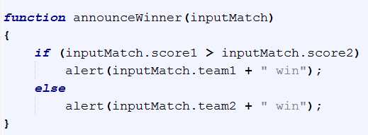

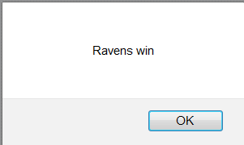
Instantiating Objects

Slide 32
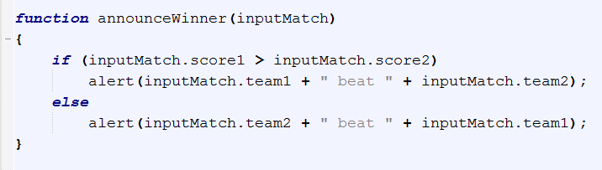
Objects
Earlier we talked about how we might want multiple object instances.
Notice our match “constructor” and how we can use it with the new keyword to create a match instance
As is common with a set of homogeneous object instances, we certainly might want to hold a bunch of objects in an array.

Slide 33
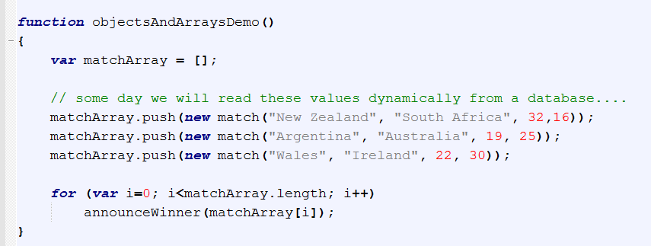
Arrays and Objects
Start with an empty array
Use the array class’s push method to add to the end – no index management required

Slide 34
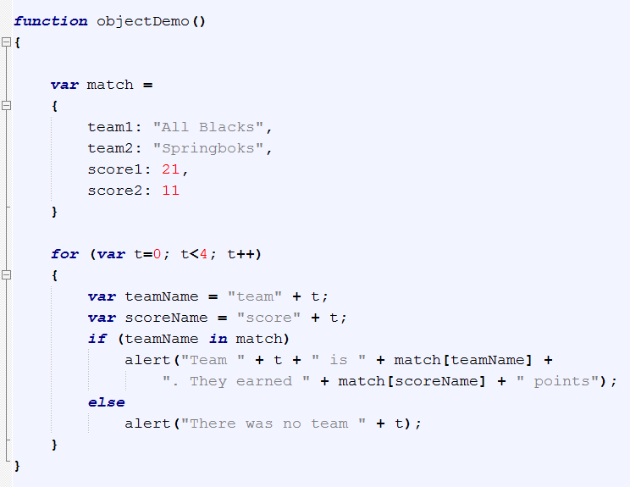
The in operator
One operator we won’t know from C++ is in.
It tests membership of a field (by field name) in an object via the key part of the key:value pairs
“If the object match contains a field called team1”

Slide 35
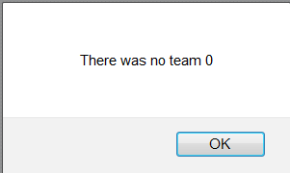
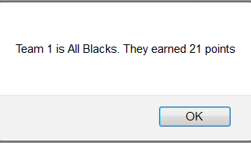
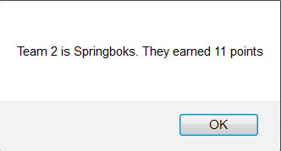
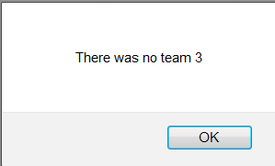
Objects
The in operator

Slide 36
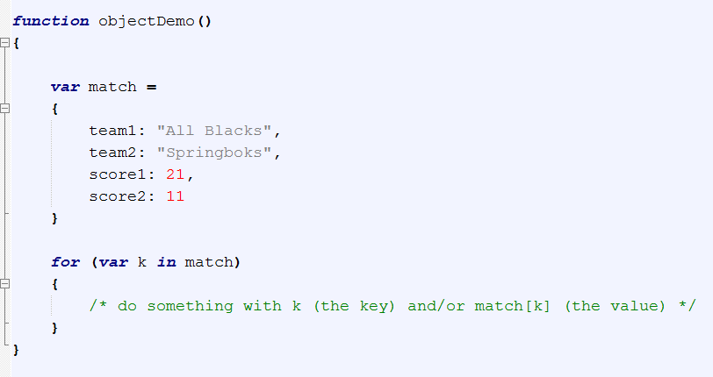
Objects
The in operator can be used to iterate over all the elements of an object.
In this usage, k will take on each key (field name) in the object, in sequence.
Sort of like a foreach loop in C#, but for keys instead of for elements in a collection.
In this case, k will take on the values “team1”, “team2”, “score1”, “score2”, in that order, and can be used exactly like string literals.
The in operator

Slide 37
Demo
http://liveweave.com/Px67A8

